Slide 1
Chapter 7: Congestion Control and Quality of Services

Slide 2
Congestion Control
Open Loop
Closed Loop

Slide 3
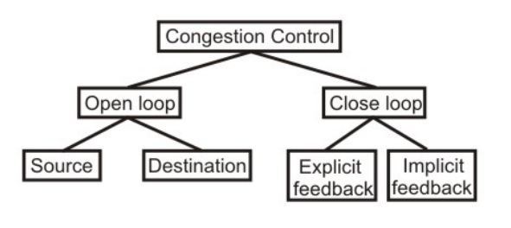
Congestion Control

Slide 4
Open Loop
Open loop congestion control is based on prevention of congestion
It prevents the congestion from happening.
It do not need end-to-end feedback.
Open loop control is exercised by using the tools such as deciding when to accept the new packets, when to discard the packets, which packets are to be discarded and making the scheduling decisions at various points
Open loop: Protocols to prevent or avoid congestion, ensuring that the system (or network under consideration) never enters a Congested State.

Slide 5
Closed Loop
Protocols that allow system to enter congested state, detect it, and remove it.
based on the concept of feedback
During operation, some system parameters are measured and feed back to portions of the subnet that can take action to reduce the congestion. This approach can be divided into 3 steps:
  Monitor the system (network) to detect whether the network is congested or not and what’s the actual location and devices involved.
  To pass this information to the places where actions can be taken Adjust the system operation to correct the problem.

Slide 6
Congestion Control Algorithms
FIFO Queue
Priority queuing

Slide 7
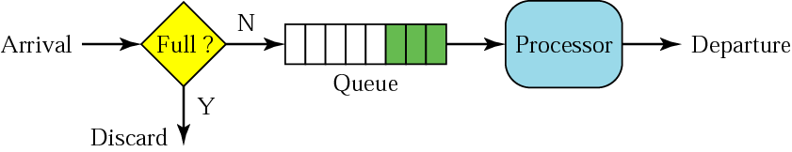
FIFO queue

Slide 8
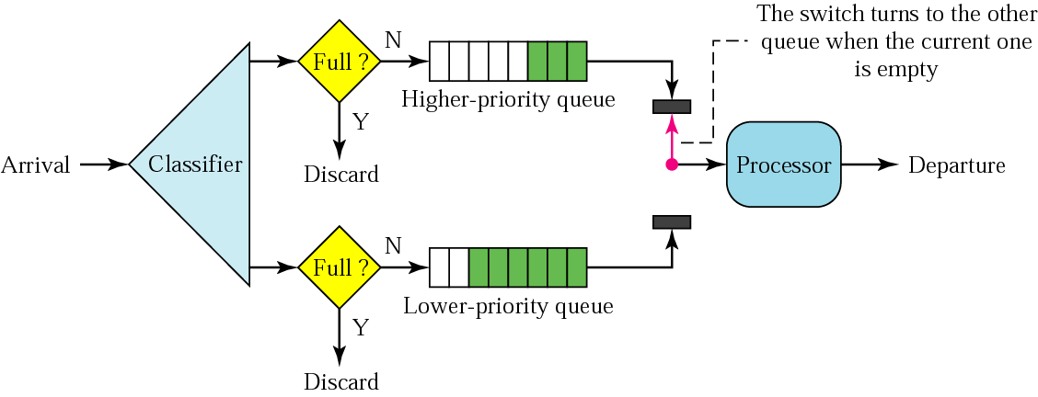
Priority queuing

Slide 9
Traffic Shaping Algorithm
Leaky Bucket
Token Bucket

Slide 10
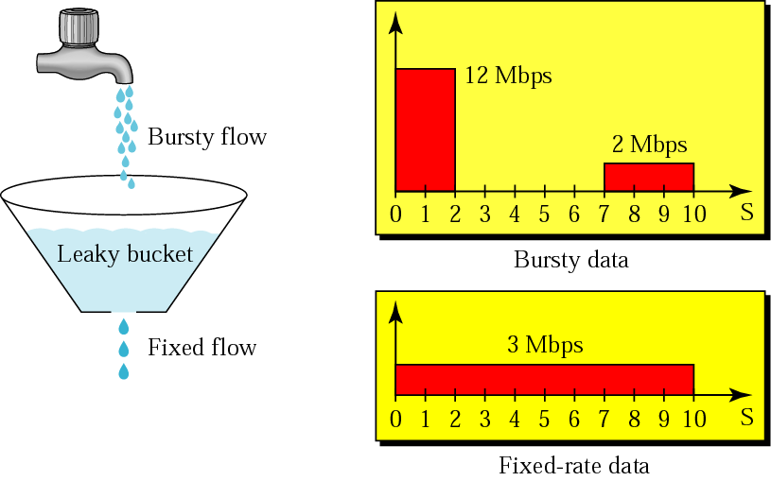
Leaky bucket

Slide 11
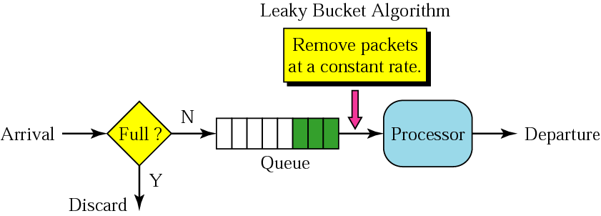
Leaky bucket implementation

Slide 12
A leaky bucket algorithm shapes bursty traffic into fixed-rate traffic by averaging the data rate. It may drop the packets if the bucket is full.

Slide 13
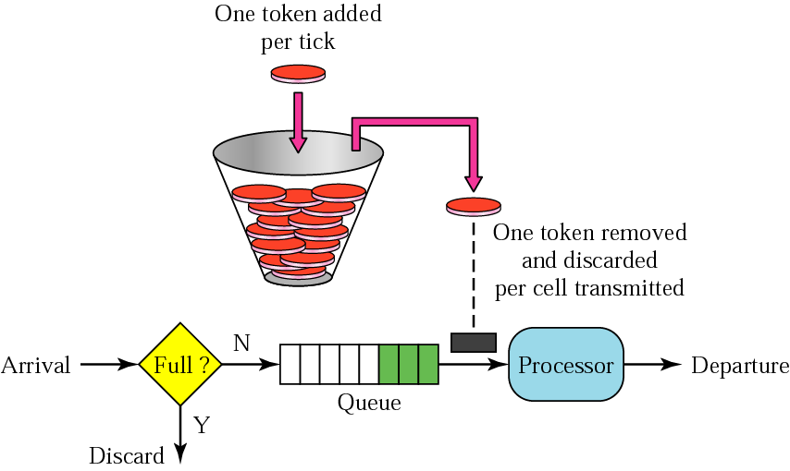
Token bucket

Slide 14
TCP Congestion Control
TCP assumes that the cause of a lost segment is due to congestion
in the network.
If the cause of the lost segment is congestion, retransmission of the segment does not remove
the cause—it aggravates it.

Slide 15
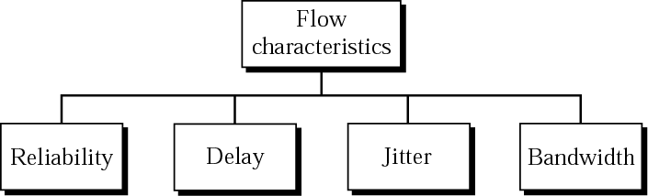
Flow characteristics

